Slide 1


CMR TECHNICAL CAMPUS
(Sponsored by CMR Technical Education Society, Reg.No: 1128/2007)
UGC AUTONOMOUS
Accredited by NBA& NAAC with ‘A’ Grade Approved by AICTE, New Delhi and JNTU, Hyderabad
Kandlakoya (V), Medchal Road, Hyderabad - 501 401 Ph.No: 9247033440/41;www.cmrtc.ac.in; info@cmrtc.ac.in
ESTD: 2 0 0 9
COMPUTER SCIENCE AND ENGINEERING
Regulation:R22
Subject Name: CRYPTOGRAPHY AND NETWORK SECURITY LAB
Topic: SECURE PASSWORD MANAGER
Subject Code: (22CS703PC)
Presentation by-
P. Tejaswi 227R1A05A7
K.Sai Krishna 227R1A0593
K.Varun 227R1A0594

Slide 2
CONTENTS
Introduction
Objectives
System architecture
Working principles
Sample code(project structure)
Demonstration steps
Results
Conclusion

Slide 3
INTRODUCTION
The Secure Password Manager is a Python-based application that allows users to store, manage, and synchronize passwords securely using advanced cryptographic techniques.
It ensures that sensitive data, such as user credentials, remains confidential, tamper-proof, and safely transmitted over the network.
The goal of this project is to develop a practical security system that demonstrates the real-world application of cryptography and network security principles.
The system uses encryption, digital signatures, and secure communication protocols to protect data both locally and during transmission.

Slide 4
OBJECTIVES
To design a password manager with AES-GCM encryption(GCM (Galois/Counter Mode) is a
special mode of AES that provides both confidentiality and integrity) for data security
To use PBKDF2 key derivation(PBKDF2 is a key derivation algorithm — it converts a user’s
password into a strong cryptographic key.) for strong encryption keys
To apply Ed25519 digital signatures(Elliptic Curve Digital Signature Algorithm) for data integrity(It’s used to verify integrity and authenticity of data.)
To transmit data securely using TLS(Transport Layer Security:encrypts the communication channel between client and server (used in HTTPS).

Slide 5
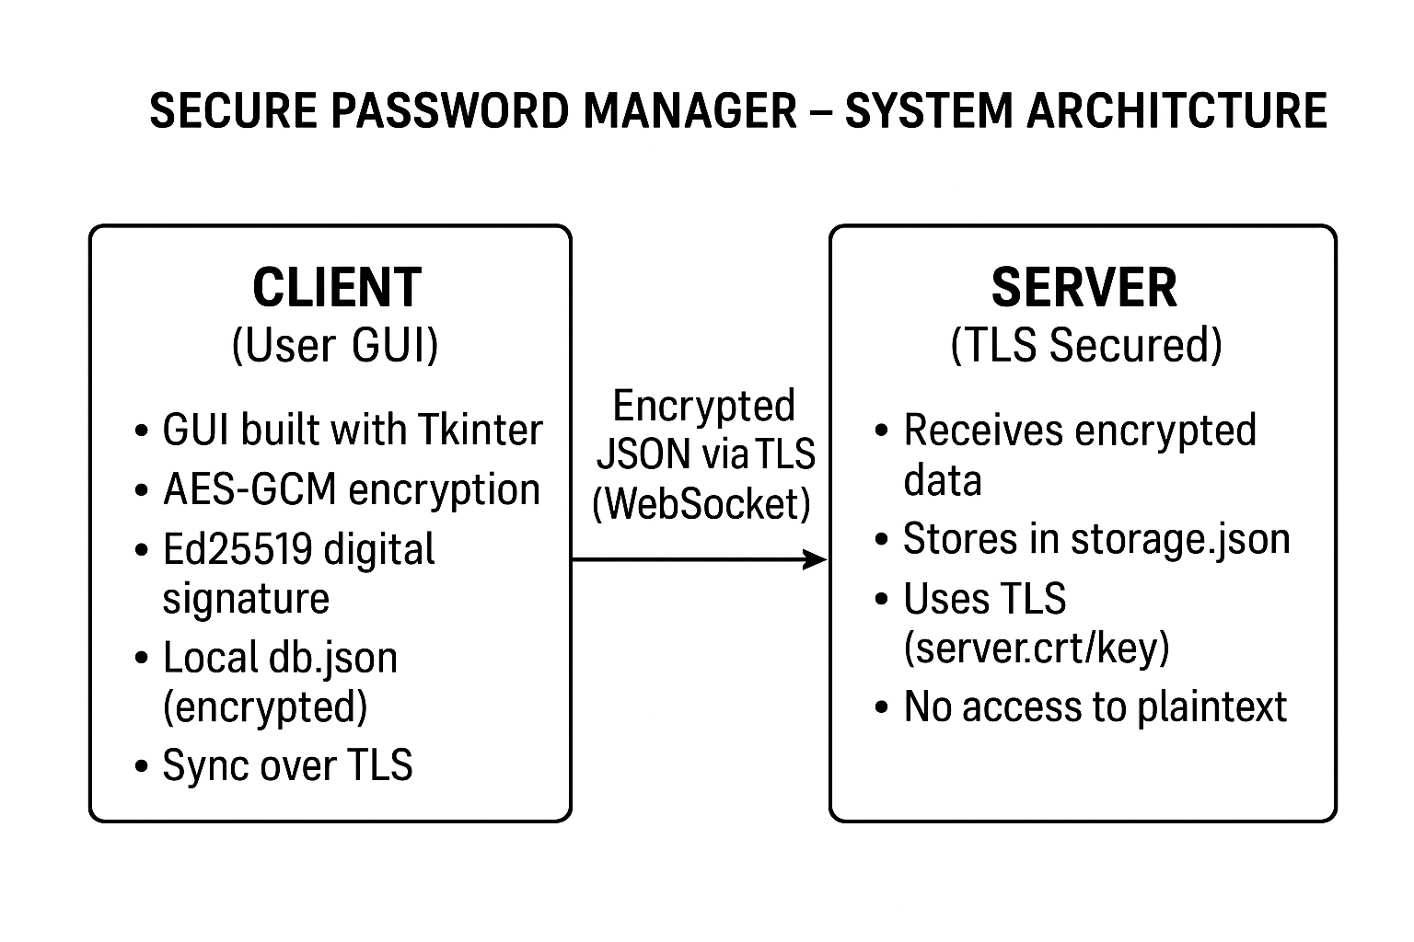
SYSTEM ARCHITECTURE

Slide 6
PRINCIPLES & FEATURES
User enters a master password.
PBKDF2 derives a 256-bit AES key.
Each password is encrypted using AES-GCM.
Ciphertext is signed using Ed25519.
Encrypted data saved in local db.json.
Sync feature sends encrypted data to server over TLS.
SECURITY FEATURES:
Confidentiality: AES-GCM encryption
Integrity: Ed25519 digital signatures
Key Protection: PBKDF2-derived AES key
Network Security: TLS (wss:// protocol)
Zero-Knowledge Storage: Server never sees plaintext

Slide 7
SAMPLE CODE
import asyncio
import json
import ssl
import websockets
STORAGE_FILE = "storage.json"
async def handler(ws):
async for msg in ws:
db = json.loads(msg)
# Store encrypted database (ciphertext + signatures)
with open(STORAGE_FILE, "w") as f:
json.dump(db, f)
await ws.send(json.dumps({"status": "ok"}))
print("[+] Received and stored encrypted data")
sslctx = ssl.SSLContext(ssl.PROTOCOL_TLS_SERVER)
sslctx.load_cert_chain(certfile="server.crt", keyfile="server.key")
start_server = websockets.serve(handler, "0.0.0.0", 8765, ssl=sslctx)
print("[Server] Listening on wss://localhost:8765")
asyncio.get_event_loop().run_until_complete(start_server)
asyncio.get_event_loop().run_forever()

Slide 8
DEMONSTRATION STEPS
Install dependencies:
pip install -r requirements.txt
Start the server:
python server.py
Start GUI Client
python gui_client.py
Open db.json → passwords appear as unreadable ciphertext.
Open storage.json → only ciphertext + signatures, no plaintext.

Slide 9
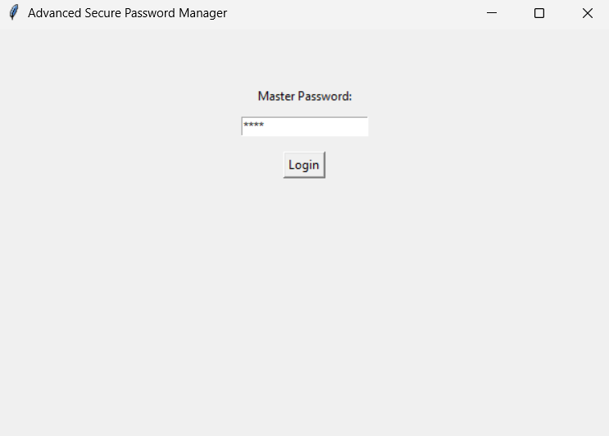
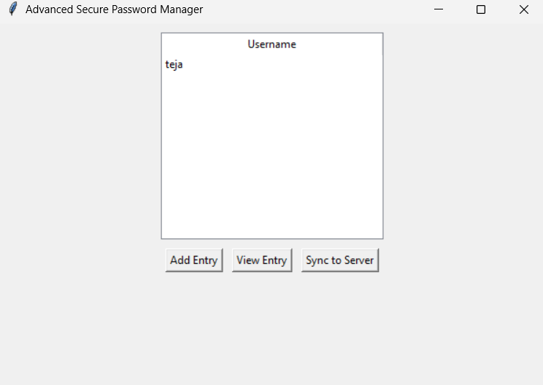
RESULTS

Slide 10
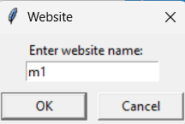
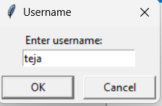
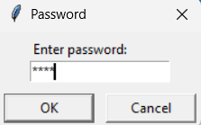
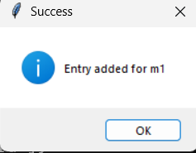
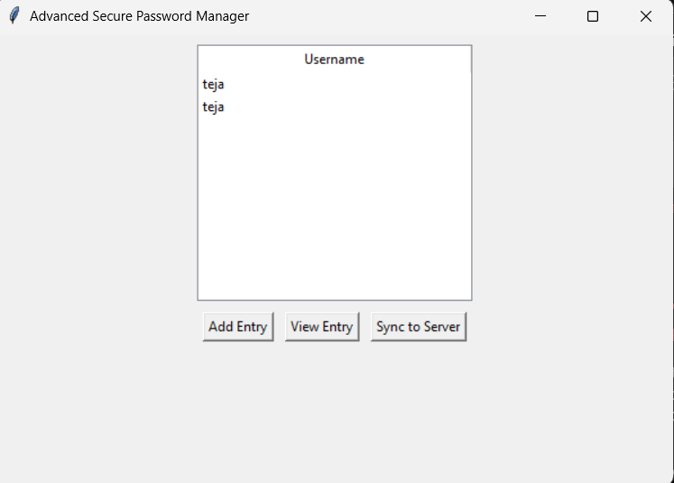
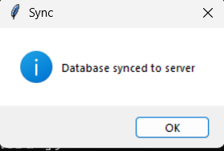

Slide 11
CONCLUSION
In this project, we successfully developed a Secure Password Manager that protects user credentials using modern cryptographic techniques and network security principles.
The system ensures confidentiality through AES-GCM encryption, integrity through Ed25519 digital signatures, and secure communication via TLS.
Passwords are encrypted locally, digitally signed, and synchronized securely to a server — which stores only encrypted data, ensuring a zero-knowledge design.
This project demonstrates how cryptography can be applied in real-world applications to build secure systems and protect sensitive information effectively.

Slide 12
THANK YOU

